Slide 1

Nested Loops
Chris Piech
CS106A, Stanford University

Slide 2
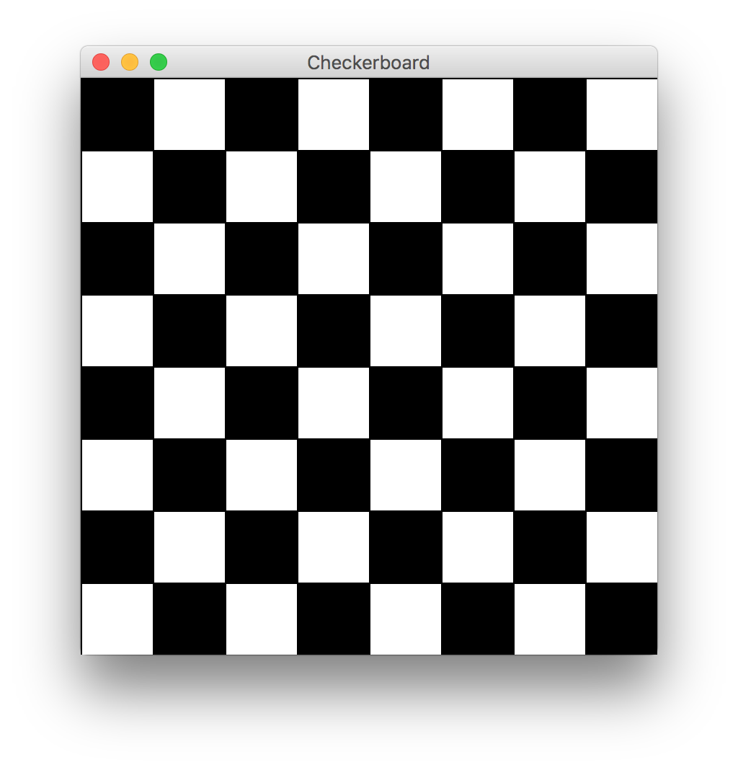

Slide 3

By Chris

Slide 4
Once upon a time…

Slide 5

X was looking for love!
int x = 5;
if(lookingForLove()) {
int y = 5;
}
println(x + y);
5
x

Slide 6
X was looking for love!
int x = 5;
if(lookingForLove()) {
int y = 5;
}
println(x + y);
5
x

Slide 7
X was looking for love!
x was definitely
looking for love
int x = 5;
if(lookingForLove()) {
int y = 5;
}
println(x + y);
5
x

Slide 8
And met y
int x = 5;
if(lookingForLove()) {
int y = 5;
}
println(x + y);
5
5
x
y

Slide 9
And met y
int x = 5;
if(lookingForLove()) {
int y = 5;
}
println(x + y);
5
5
Hi, I’m y
x
y

Slide 10
“Wow!”

Slide 11
And met y
int x = 5;
if(lookingForLove()) {
int y = 5;
}
println(x + y);
Wow
5
5
x
y

Slide 12
And met y
int x = 5;
if(lookingForLove()) {
int y = 5;
}
println(x + y);
5
5
We have so much in common
x
y

Slide 13
And met y
int x = 5;
if(lookingForLove()) {
int y = 5;
}
println(x + y);
5
5
We both have value 5!
x
y

Slide 14
And met y
int x = 5;
if(lookingForLove()) {
int y = 5;
}
println(x + y);
5
5
Maybe one day we can…
x
y

Slide 15
And met y
int x = 5;
if(lookingForLove()) {
int y = 5;
}
println(x + y);
5
5
println together?
x
y

Slide 16
They got along
int x = 5;
if(lookingForLove()) {
int y = 5;
}
println(x + y);
5
5
x
y

Slide 17
It was a beautiful match…

Slide 18
But then tragedy struck.

Slide 19
Tragedy Struck
int x = 5;
if(lookingForLove()) {
int y = 5;
}
println(x + y);
5
5
x
y

Slide 20
Tragedy Struck
int x = 5;
if(lookingForLove()) {
int y = 5;
}
println(x + y);
5
5
x
y

Slide 21

Tragedy Struck
int x = 5;
if(lookingForLove()) {
int y = 5;
}
println(x + y);
5
x

Slide 22
Noooooooooooooooo!

Slide 23
You see…

Slide 24
When a program exits a code block…
int x = 5;
if(lookingForLove()) {
int y = 5;
}
println(x + y);
5
x

Slide 25
All variables declared inside that block..
int x = 5;
if(lookingForLove()) {
int y = 5;
}
println(x + y);
5
x

Slide 26
Get deleted from memory!
int x = 5;
if(lookingForLove()) {
int y = 5;
}
println(x + y);
5
x

Slide 27
Since y was declared in the if-block
int x = 5;
if(lookingForLove()) {
int y = 5;
}
println(x + y);
5
x

Slide 28
It gets deleted from memory here
int x = 5;
if(lookingForLove()) {
int y = 5;
}
println(x + y);
5
x

Slide 29
And doesn’t exist here
int x = 5;
if(lookingForLove()) {
int y = 5;
}
println(x + y);
5
x

Slide 30
And doesn’t exist here
Error. Undefined variable y.
int x = 5;
if(lookingForLove()) {
int y = 5;
}
println(x + y);
5
x

Slide 31
The End

Slide 32
Sad times ☹

Slide 33
Variables have a lifetime (called scope)
public void run(){
double v = 8;
if(condition){
v = 4;
… some code
}
… some other code
}

Slide 34
Variables have a lifetime (called scope)
public void run(){
double v = 8;
if(condition){
v = 4;
… some code
}
… some other code
}

Slide 35
Vars come to existence when declared
public void run(){
double v = 8;
if(condition){
v = 4;
… some code
}
… some other code
}
Comes to life here
8
v

Slide 36
Live until end of their code block
public void run(){
double v = 8;
if(condition){
v = 4;
… some code
}
… some other code
}
This is the inner most
code block in which it was
declared….
4
v

Slide 37
Live until end of their code block
public void run(){
double v = 8;
if(condition){
v = 4;
… some code
}
… some other code
}
Still alive here…
4
v

Slide 38
Live until end of their code block
public void run(){
double v = 8;
if(condition){
v = 4;
… some code
}
… some other code
}
4
v
It dies here (at the end of its code block)

Slide 39

Live until end of their code block
public void run(){
double v = 8;
if(condition){
v = 4;
… some code
}
… some other code
}
It dies here (at the end of its code block)

Slide 41
Example 2
public void run(){
… some code
if(condition){
int w = 4;
… some code
}
… some other code
}
This is the scope of w

Slide 42
Example 2
public void run(){
… some code
if(condition){
int w = 4;
… some code
}
… some other code
}
w comes to life here
w dies here (at the end of its code block)

Slide 43
Chapter 2

Slide 44
The programmer fixed her bug

Slide 45
x was looking for love!
int x = 5;
if(lookingForLove()) {
int y = 5;
println(x + y);
}
5
x

Slide 46
x was looking for love…
x was definitely
looking for love
int x = 5;
if(lookingForLove()) {
int y = 5;
println(x + y);
}
5
x

Slide 47
x met y
int x = 5;
if(lookingForLove()) {
int y = 5;
println(x + y);
}
5
5
x
y

Slide 48
Since they were both “in scope”
int x = 5;
if(lookingForLove()) {
int y = 5;
println(x + y);
}
5
5
x
y

Slide 49
The story had a happy ending!

Slide 50
Scope Formally
The scope of a variable refers to the section of code where a variable can be accessed.
Scope starts where the variable is declared.
Scope ends at the termination of the inner-most code block in which the variable was defined.
A code block is a chunk of code between { } brackets

Slide 51
Back to our regularly scheduled program…

Slide 52
How would you println “Stanford rocks socks”
100 times

Slide 53
For Loop Redux
public void run() {
for(int i = 0; i < 100; i++) {
println(“Stanford rocks socks!”);
}
}

Slide 54
For Loop Redux
Enters the loop if this condition passes
This line is run each time the code gets to the end of the ‘body’
This line is run once, just before the for loop starts
for(int i = 0; i < 100; i++) {
println(“Stanford rocks socks!”);
}

Slide 55

For Loop Redux
for(int i = 0; i < 3; i++) {
println(“Stanford rocks socks!”);
}
For Loop Redux

Slide 56
For Loop Redux
for(int i = 0; i < 3; i++) {
println(“Stanford rocks socks!”);
}
For Loop Redux

Slide 57
For Loop Redux
i
0
for(int i = 0; i < 3; i++) {
println(“Stanford rocks socks!”);
}
For Loop Redux

Slide 58
For Loop Redux
i
0
for(int i = 0; i < 3; i++) {
println(“Stanford rocks socks!”);
}
For Loop Redux

Slide 59
For Loop Redux
i
0
for(int i = 0; i < 3; i++) {
println(“Stanford rocks socks!”);
}
For Loop Redux
Stanford rocks socks

Slide 60
For Loop Redux
i
1
for(int i = 0; i < 3; i++) {
println(“Stanford rocks socks!”);
}
For Loop Redux
Stanford rocks socks

Slide 61
For Loop Redux
i
1
for(int i = 0; i < 3; i++) {
println(“Stanford rocks socks!”);
}
For Loop Redux
Stanford rocks socks

Slide 62
For Loop Redux
i
1
for(int i = 0; i < 3; i++) {
println(“Stanford rocks socks!”);
}
For Loop Redux
Stanford rocks socks
Stanford rocks socks

Slide 63
For Loop Redux
i
2
for(int i = 0; i < 3; i++) {
println(“Stanford rocks socks!”);
}
For Loop Redux
Stanford rocks socks
Stanford rocks socks

Slide 64
For Loop Redux
i
2
for(int i = 0; i < 3; i++) {
println(“Stanford rocks socks!”);
}
For Loop Redux
Stanford rocks socks
Stanford rocks socks

Slide 65
For Loop Redux
i
2
for(int i = 0; i < 3; i++) {
println(“Stanford rocks socks!”);
}
For Loop Redux
Stanford rocks socks
Stanford rocks socks
Stanford rocks socks

Slide 66
For Loop Redux
i
3
for(int i = 0; i < 3; i++) {
println(“Stanford rocks socks!”);
}
For Loop Redux
Stanford rocks socks
Stanford rocks socks
Stanford rocks socks

Slide 67
For Loop Redux
i
3
for(int i = 0; i < 3; i++) {
println(“Stanford rocks socks!”);
}
For Loop Redux
Stanford rocks socks
Stanford rocks socks
Stanford rocks socks

Slide 68
For Loop Redux
for(int i = 0; i < 3; i++) {
println(“Stanford rocks socks!”);
}
For Loop Redux
Stanford rocks socks
Stanford rocks socks
Stanford rocks socks

Slide 69
For Loop Redux
for(int i = 0; i < 3; i++) {
println(“Stanford rocks socks!”);
}
For Loop Redux
Stanford rocks socks
Stanford rocks socks
Stanford rocks socks

Slide 70
You can use the for loop variable

Slide 71
How would you println the first 100 even numbers?

Slide 72
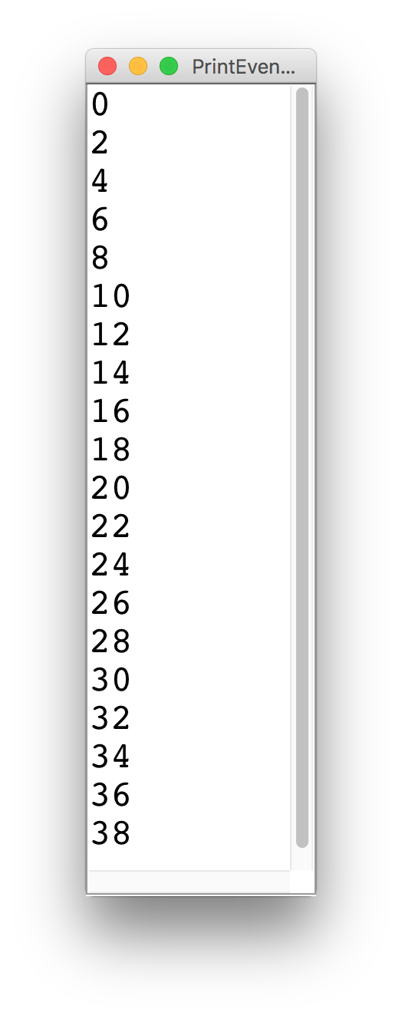
Printing Even Numbers

Slide 73
Printing Even Numbers
for(int i = 0; i < NUM_NUMS; i++) {
println(i * 2);
}

Slide 74
Printing Even Numbers
for(int i = 0; i < 3; i++) {
println(i * 2);
}
For Loop Redux

Slide 75
Printing Even Numbers
for(int i = 0; i < 3; i++) {
println(i * 2);
}
For Loop Redux

Slide 76
Printing Even Numbers
i
0
for(int i = 0; i < 3; i++) {
println(i * 2);
}
For Loop Redux

Slide 77
Printing Even Numbers
i
0
for(int i = 0; i < 3; i++) {
println(i * 2);
}
For Loop Redux

Slide 78
Printing Even Numbers
i
0
for(int i = 0; i < 3; i++) {
println(i * 2);
}
For Loop Redux
0

Slide 79
Printing Even Numbers
i
1
for(int i = 0; i < 3; i++) {
println(i * 2);
}
For Loop Redux
0

Slide 80
Printing Even Numbers
i
1
for(int i = 0; i < 3; i++) {
println(i * 2);
}
For Loop Redux
0

Slide 81
Printing Even Numbers
i
1
for(int i = 0; i < 3; i++) {
println(i * 2);
}
For Loop Redux
0
2

Slide 82
Printing Even Numbers
i
2
for(int i = 0; i < 3; i++) {
println(i * 2);
}
For Loop Redux
0
2

Slide 83
Printing Even Numbers
i
2
for(int i = 0; i < 3; i++) {
println(i * 2);
}
For Loop Redux
0
2

Slide 84
Printing Even Numbers
i
2
for(int i = 0; i < 3; i++) {
println(i * 2);
}
For Loop Redux
0
2
4

Slide 85
Printing Even Numbers
i
3
for(int i = 0; i < 3; i++) {
println(i * 2);
}
For Loop Redux
0
2
4

Slide 86
Printing Even Numbers
i
3
for(int i = 0; i < 3; i++) {
println(i * 2);
}
For Loop Redux
0
2
4

Slide 87
Printing Even Numbers
i
3
for(int i = 0; i < 3; i++) {
println(i * 2);
}
For Loop Redux
0
2
4

Slide 88
Printing Even Numbers
for(int i = 0; i < 3; i++) {
println(i * 2);
}
For Loop Redux
0
2
4

Slide 89
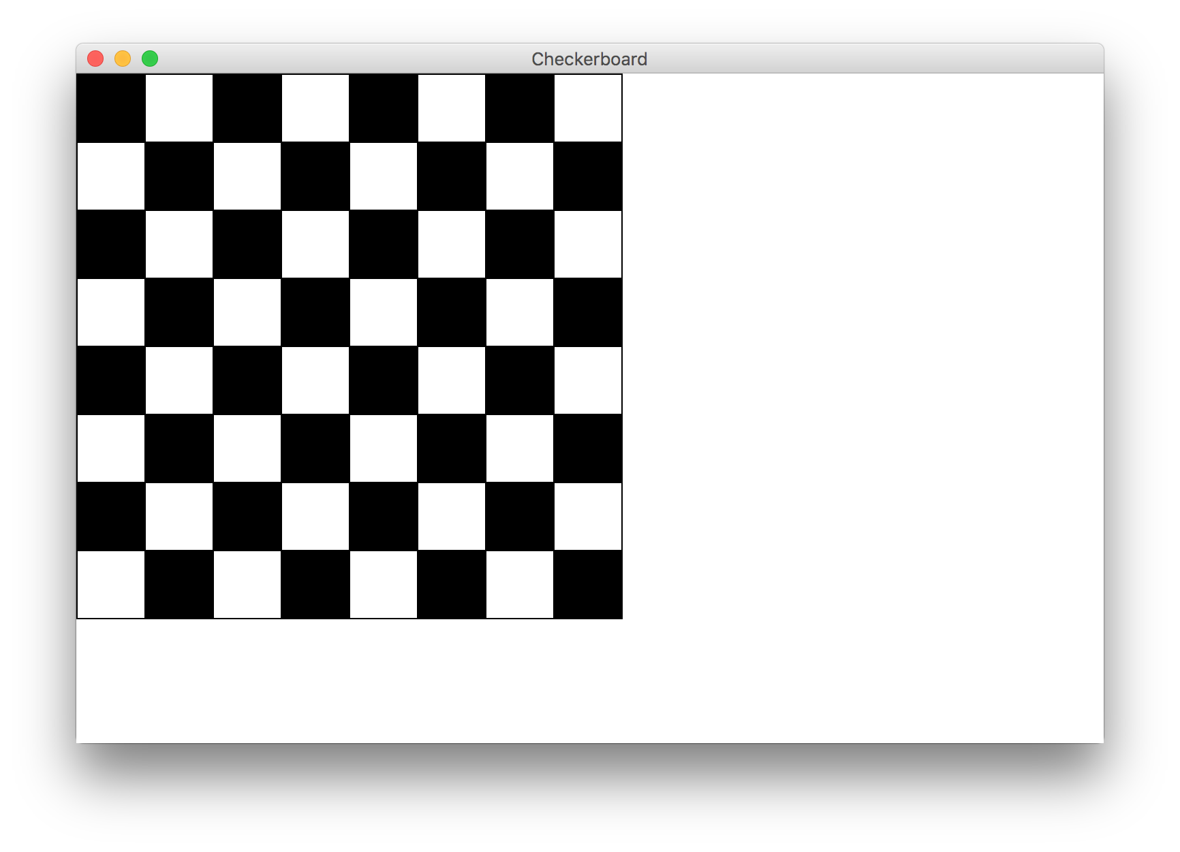

Slide 90
Types of Programs
Program
Karel Program
Console Program
Graphics Program
SuperKarel Program

Slide 91
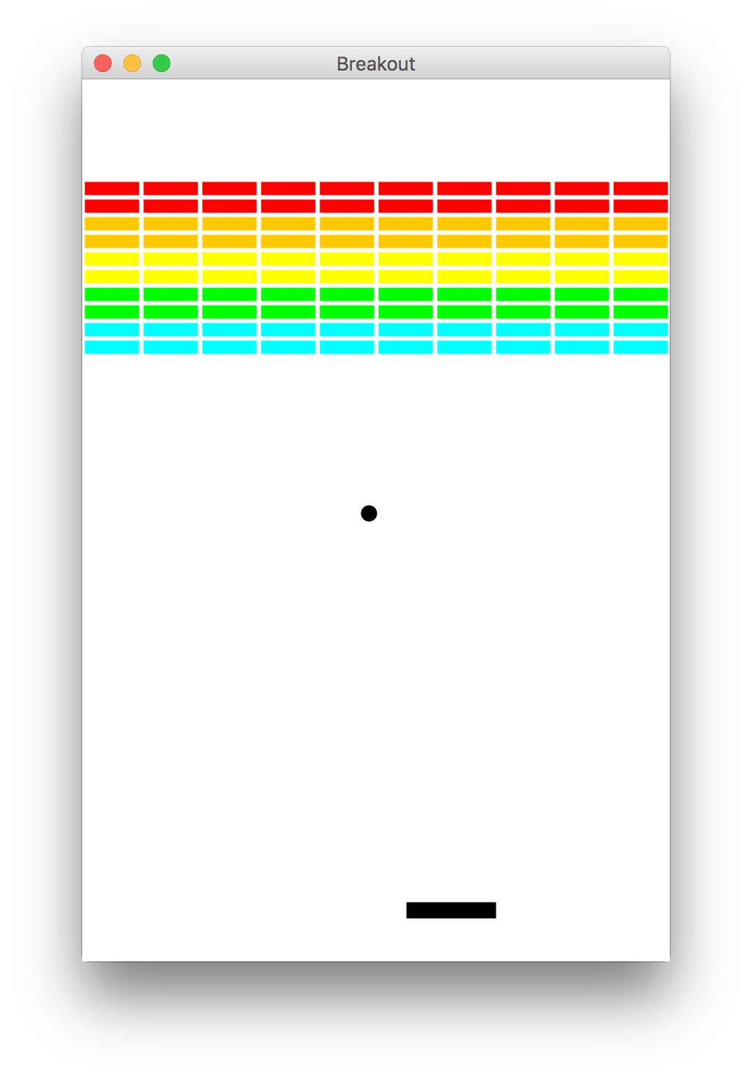
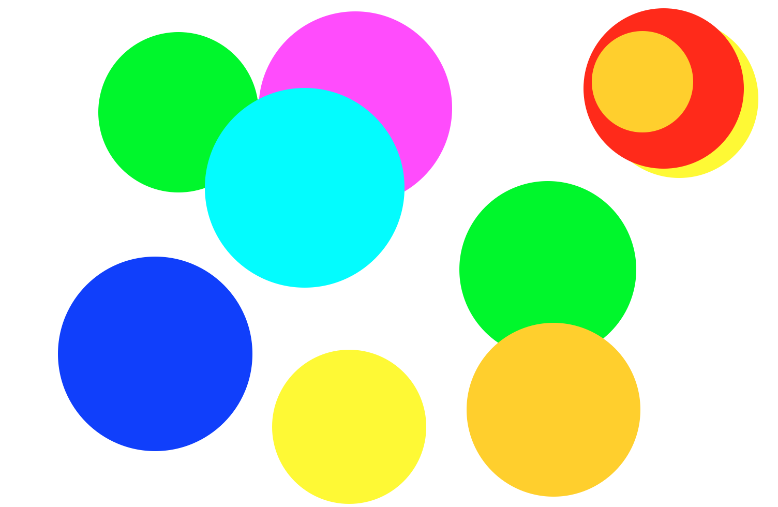
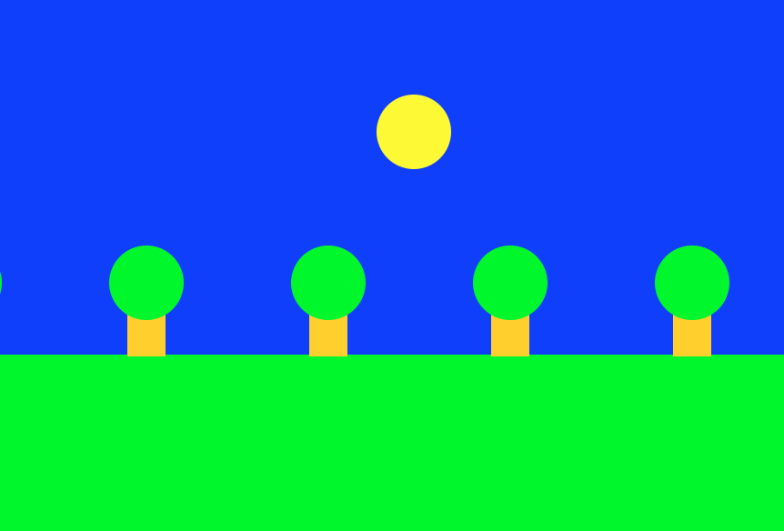
Graphics Programs

Slide 92
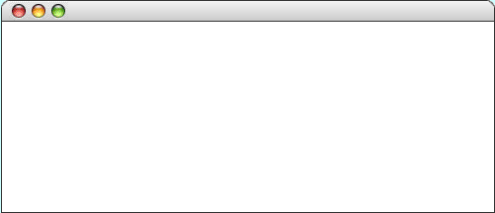
GRect
GRect is a variable type that stores a rectangle.
As an example, the following run method displays a blue square
public void run() {
Grect rect = new GRect(50, 50, 200, 200);
rect.setFilled(true);
rect.setColor(Color.BLUE);
add(rect);
}
LargestOval

Slide 93
Graphics Coordinates
0,0
40,20
120,40
getHeight();
40,120
getWidth();

Slide 94
GOval
The GOval class represents an elliptical shape defined by the boundaries of its enclosing rectangle.
As an example, the following run method creates the largest oval that fits within the canvas:
public void run() {
GOval oval = new GOval(0, 0, getWidth(), getHeight());
oval.setFilled(true);
oval.setColor(Color.GREEN);
add(oval);
}
LargestOval

Slide 95
Graphics Variable Types
GObject
GLabel
GRect
GOval
others…
GRect myRect = new GRect(350, 270);

Slide 96
Primitives vs Classes
Primitive Variable Types
Class Variable Types
int
double
char
boolean
GRect
GOval
GLine
…
Class variables:
Have upper camel case types
You can call methods on them
Are constructed using new
Are stored in a special way

Slide 97
Goal

Slide 98
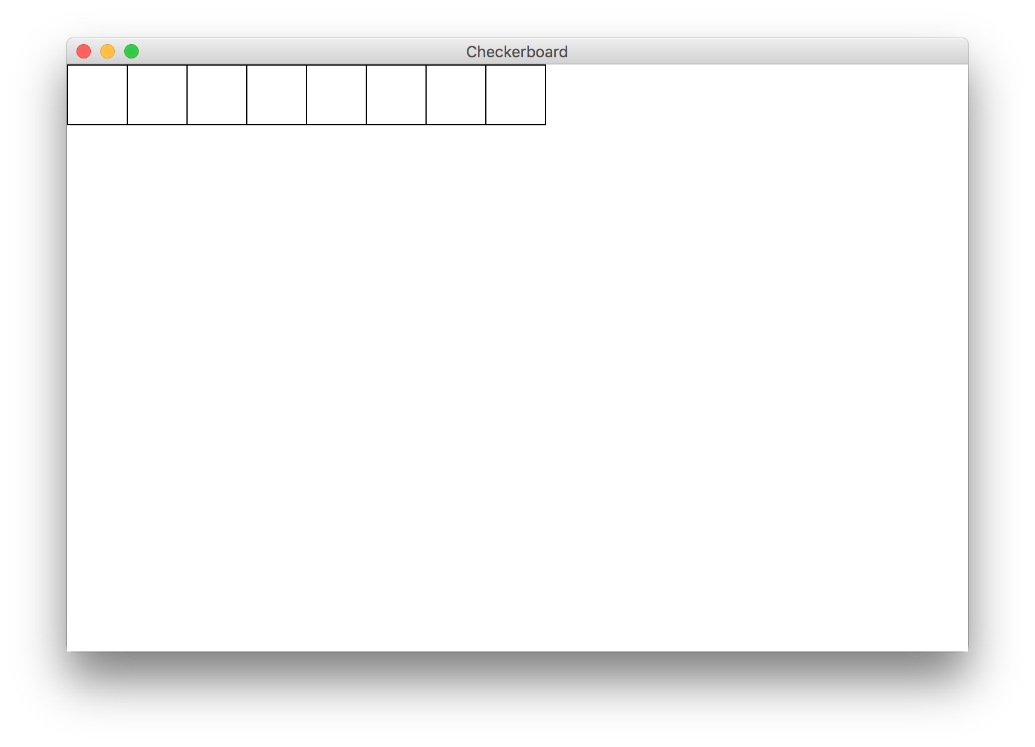
Milestone 1

Slide 99
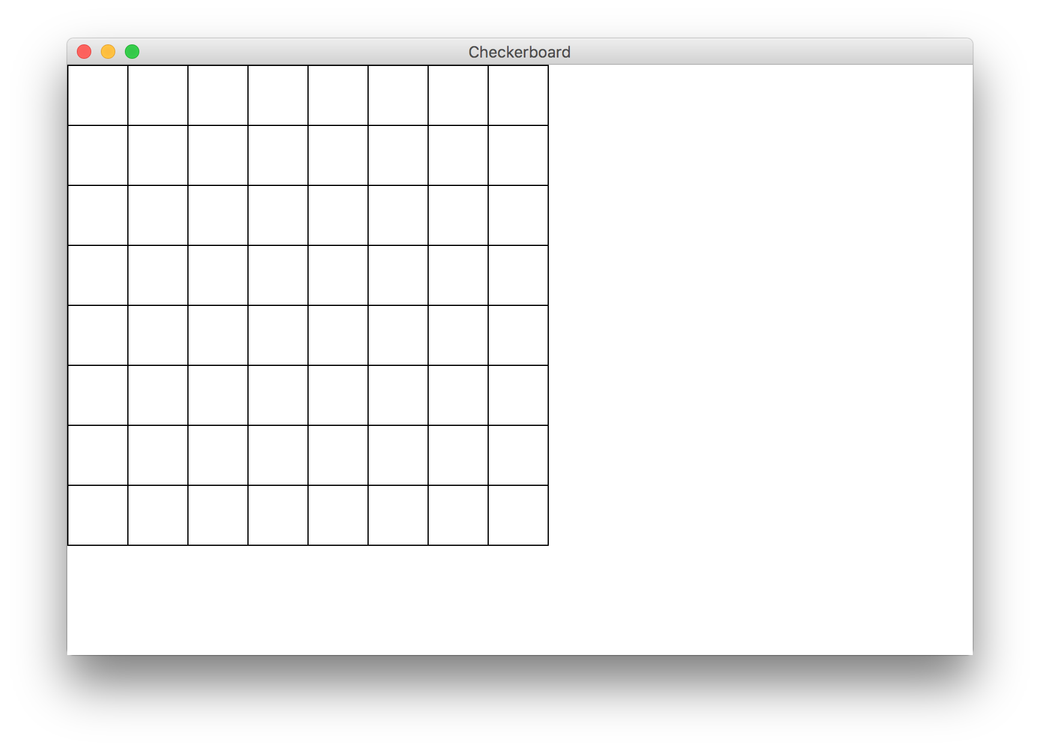
Milestone 2

Slide 100
Milestone 3

